Slide 1

PDAS CA2
LIM JUN YI
DAAA/FT/1B/03
P2308924

Slide 2
General Analysis Question
What is employment
in Singapore affected by?

Slide 3
Background Information
Employment is something everyone needs to face when they grow old as money doesn't just come from the sky for free. Expenses, responsibilities, daily expenditures are a part of life, and we will need to have the ability to cover them to progress in life.
In this data analysis, I will be looking at employment and how different factors affect the rate of employment. I'm currently a Year 1 Poly Student and am interested in how I can improve in order to get the best chance when I graduate.

Slide 4
Sub-Analysis Questions
Before we begin to analyse the datasets chosen, I have formed some questions under the main General Analysis Question to allow myself to begin the thinking process even before plotting the graphs.
Is Salary really a main factor affecting employment in Singapore?
Which factor has the most impact on employment?
Are there any potential solutions to help employment in Singapore?

Slide 5
Dataset Analysis Process
Exploratory Data Analysis (EDA)
Graph / Plot
on the dataset
- Find out what the data contains, data types, shape of the data
- Find more information on the data
- Plotting a graph/chart that is suitable for that dataset
- Visualize and analyse the plot

Slide 6
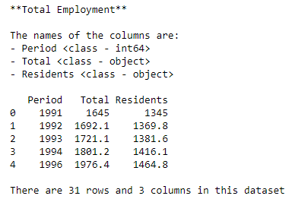
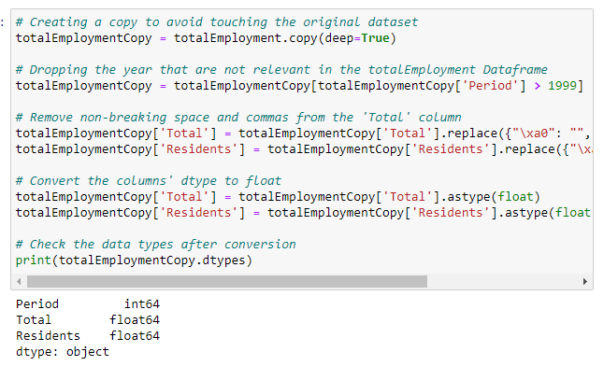
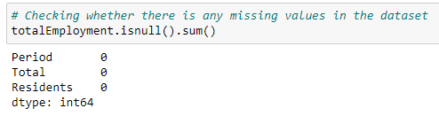
Employment in Singapore
EDA on the dataset
Data Manipulation
Checking for missing values

Slide 7
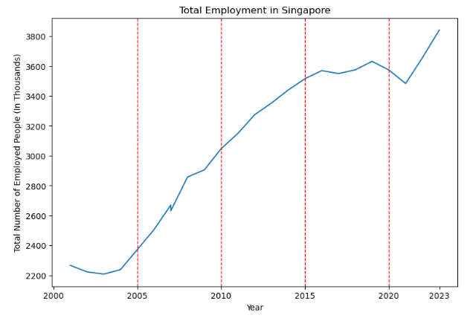
Employment in Singapore
I will be analysing the employment in Singapore by 3 sections:
Section 1 – 2005 to 2010
Section 2 – 2010 to 2015
Section 3 – 2015 to 2020
This will give me a wider range of data to analyze between each section, which can give a more informative on why.
Observation:
There is a moderately positive trend throughout the 3 sections.
I will begin to analyse why there is positive trend in the employment in Singapore.

Slide 8
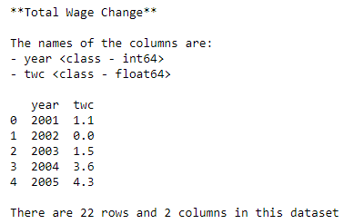
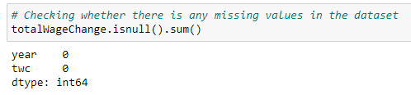
Total Wage Change
Checking for missing values
EDA on the dataset

Slide 9
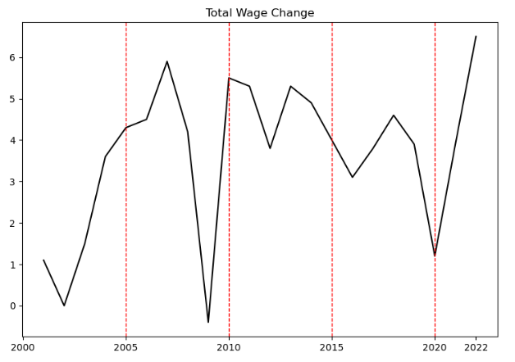
Total Wage Change
Observation:
Around 2008 - 2009, there was a massive dip in total wage . Section 1 had the highest peak, but the lowest dip.
Section 2 had the more stable total wage change.
Section 3 had generally a lower total wage change compared to section 2, and it ended with a low dip.
I can tell that there is a poor relationship between the total wage change & employment in Singapore as there is no clear trend noticed in the line plot.

Slide 10
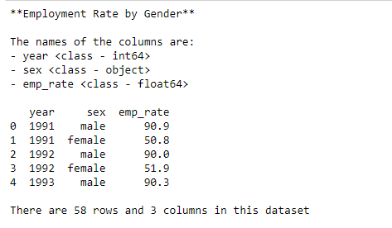
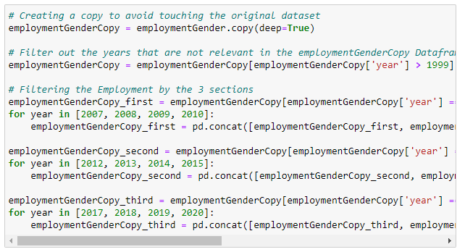
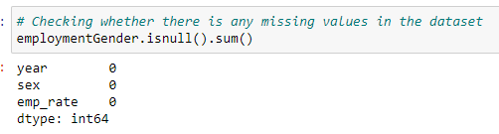
Employment Rate by Gender
EDA on the dataset
Data Manipulation
Checking for missing values

Slide 11
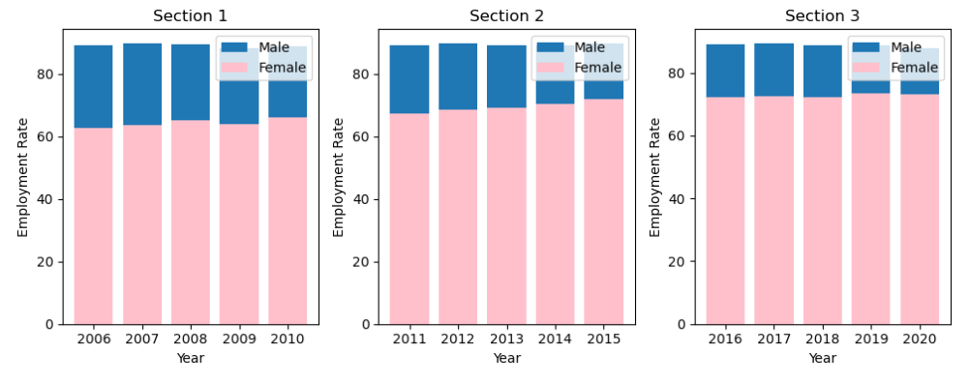
Employment Rate by Gender
Observation:
When simply glancing through it, there doesn't seem to have much of a difference between the 3 sections.
However, after closer observation, there is a slight increase of the employment rate for the females, which contributes to the increase of employment.
This suggests that companies are beginning to take in more females into the workforce.

Slide 12
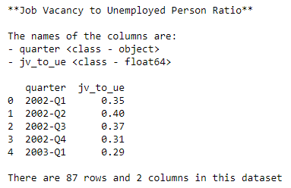
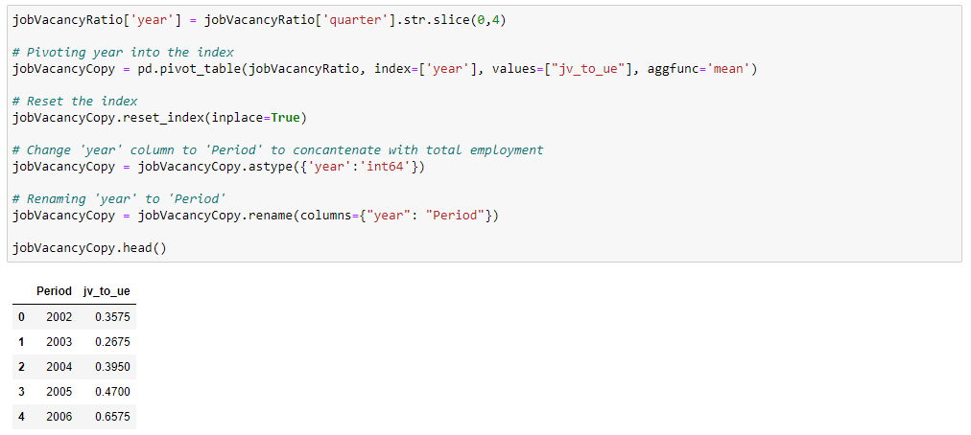
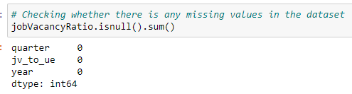
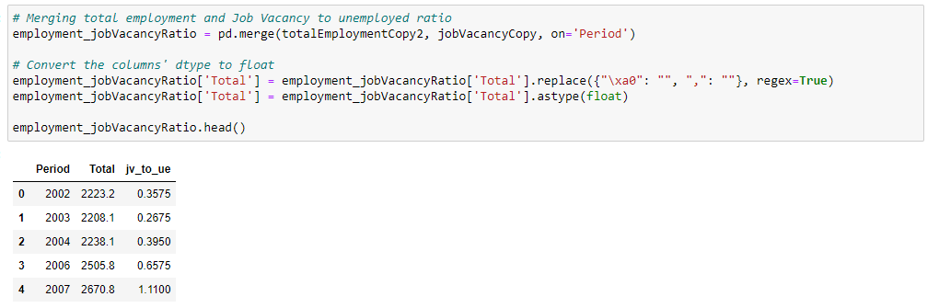
Job Vacancy to Unemployed Person Ratio
Data Manipulation & Transforming the tables
EDA on the dataset
Changing the dtype to allow merging
Checking for missing values
Merging employment & job vacancy ratio tables together

Slide 13
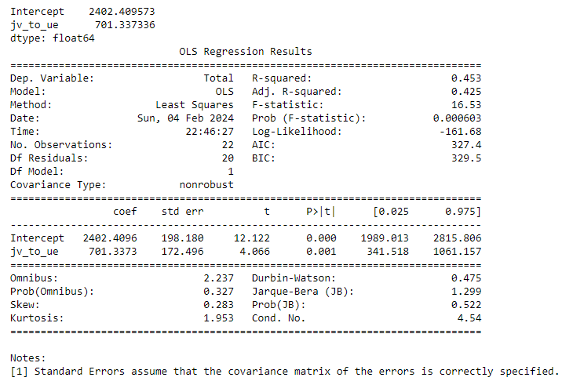
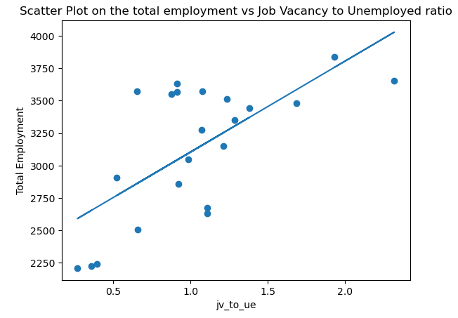

Job Vacancy to Unemployed Person Ratio
R-Squared suggests model had predicted the values moderately
Total employment = 2402.209 + 701.337 * (J.V.U.P.R.)
This suggests that when the ratio of jobs available to unemployed is 1, the total employment increases by an estimated amount of 701 thousand people who are employed.
According to the Pearson correlation coefficient, the correlation coefficient between is 0.67, which suggests that the relationship is positively moderate.
This means that there's still other factors that have a higher impact towards employment in SG.

Slide 14
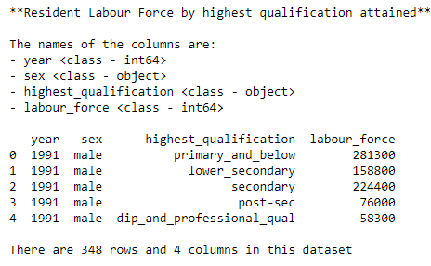
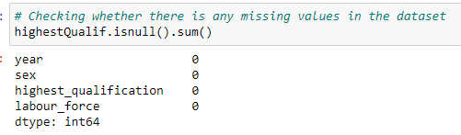
Labour Force by highest qualification attained
Checking for missing values
EDA on the dataset

Slide 15
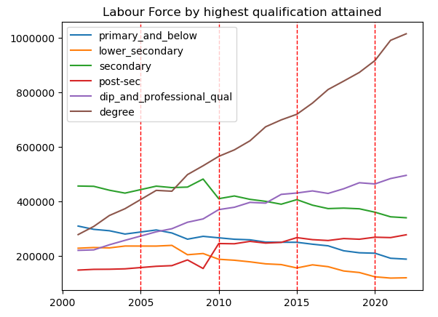
Labour Force by highest qualification attained
Observation:
‘Degree’ holders have increase drastically throughout the 3 sections.
Other qualifications have either increase or decrease slightly.
This suggests that majority of the companies are beginning to look for ‘Degree’ holders more than any other qualifications.
The positive trend of ‘Degree’ holders looks similar to the increasing trend of employment in SG → this suggests that qualifications are important to employment (‘Degree’ holders).

Slide 16
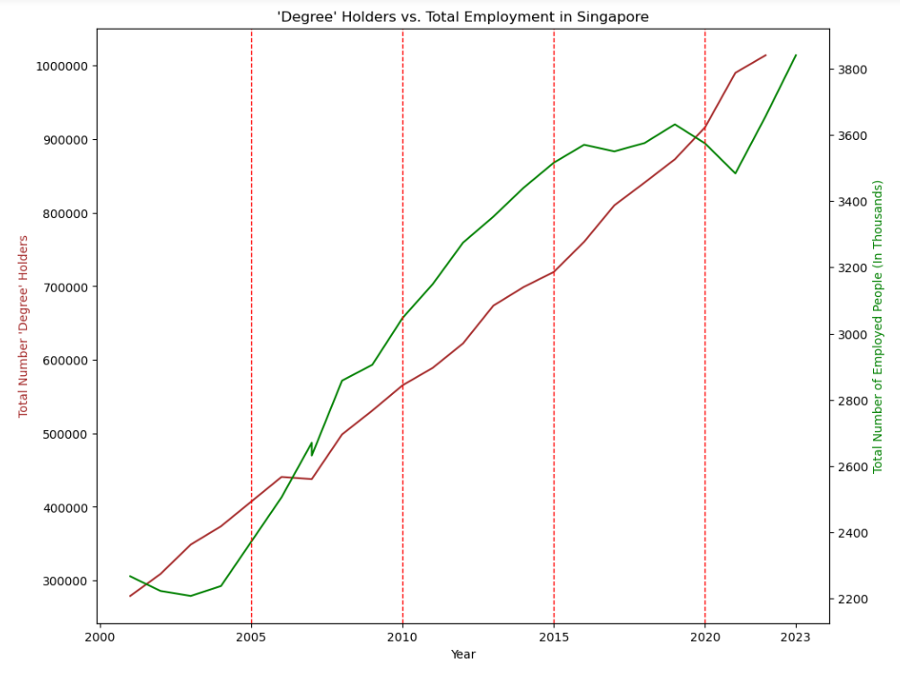
Labour Force by highest qualification attained
To observe better on the relationship between Total Employment & Total ‘Degree’ holders in SG.
Observation:
The trends for both ‘Degree’ holders and Total Employment have similar shapes.
This suggests that the relationship between the 2 is most likely positively strong.
I can conclude that having a high qualification (e.g. ‘Degree’) has a huge impact on the total employment in Singapore.

Slide 17
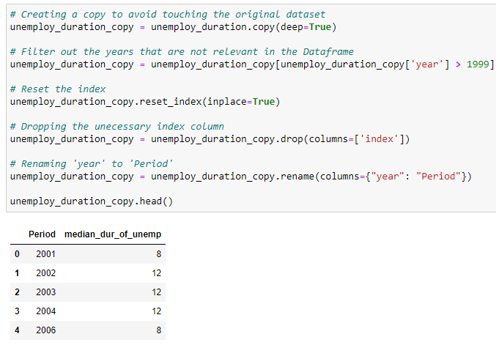
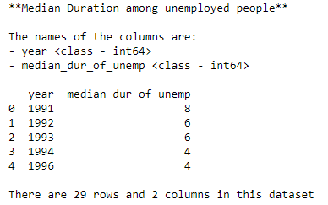
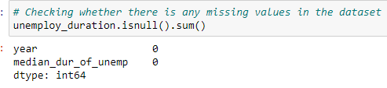
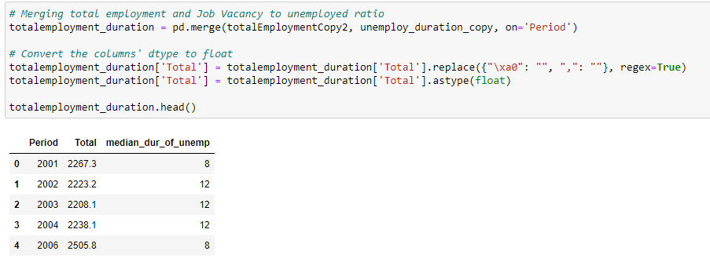
Median Duration among Unemployed people
Transforming the dataset to allow merging
EDA on the dataset
Checking for missing values
Changing of dtype &
merging employment with duration

Slide 18
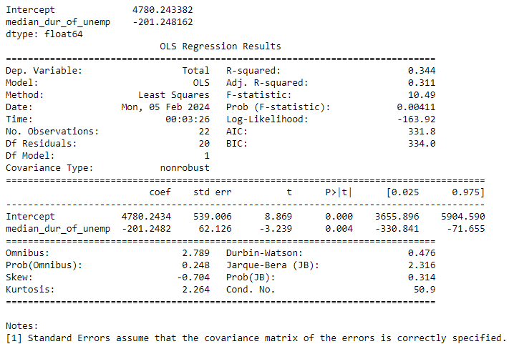
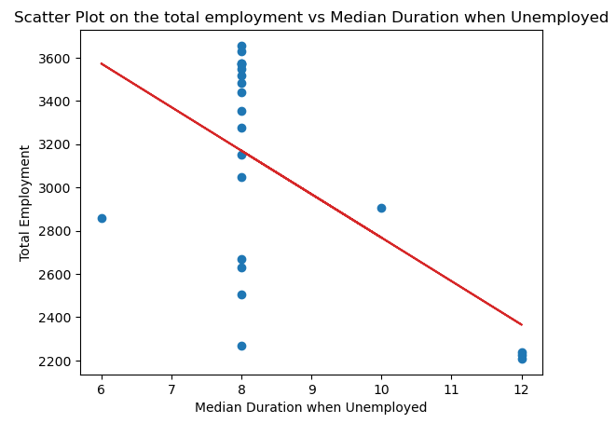

Median Duration among Unemployed people
Low R-squared suggests the model predicted poorly
According to the Pearson correlation coefficient, the correlation coefficient between the variables is -0.59, which suggests that the relationship is negatively moderate.
However, since linear model's prediction (red line) fits the graph poorly, I will not be making any predictions.
Total employment = 4780.243 - 201.248 * (Duration)
This suggests that the higher the duration of a person being unemployed, the lower the total employment is in Singapore.

Slide 19
Average Monthly Household Expenditure Among Resident Households
For this analysis, I will be using the monthly household expenditure to compare throughout the 3 sections. Therefore, I will be comparing the average monthly household expenditure around the middle years of the 3 sections.
This dataset contains the average monthly household expenditure for household sizes of 1 to 6, which is useful as it covers a wide range of the households in Singapore.
However, I couldn’t find the dataset that is in between section 1 (2005 - 2010), so I had to compromise and use a dataset that is for the years 2002 – 2003.
I chose to compromise instead of changing datasets as my focus for this analysis is to observe if there are any trends present in the charts. If there is, I can then relate it back to how it affects employment in Singapore.

Slide 20
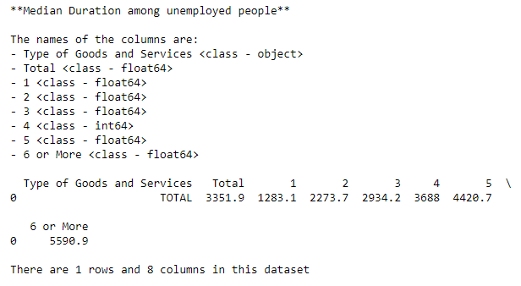
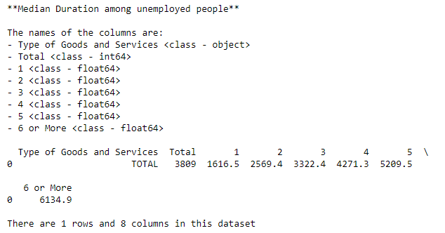
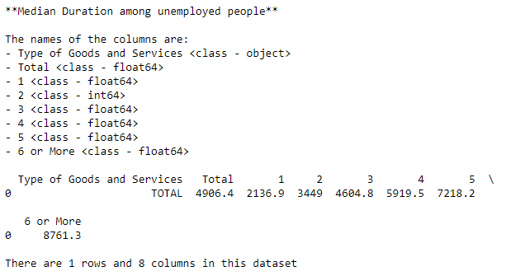
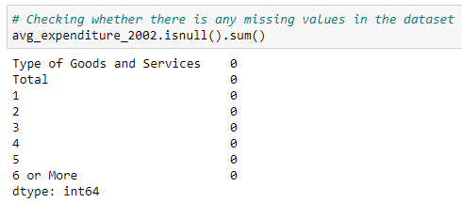
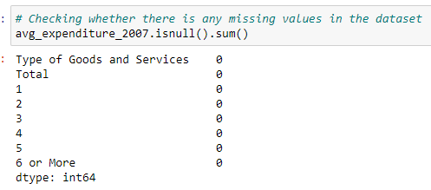
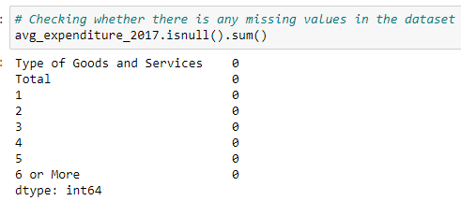
Average Monthly Household Expenditure Among Resident Households
EDA on 2002/03 dataset
EDA on 2007/08 dataset
EDA on 2017/18 dataset
Checking for missing values

Slide 21
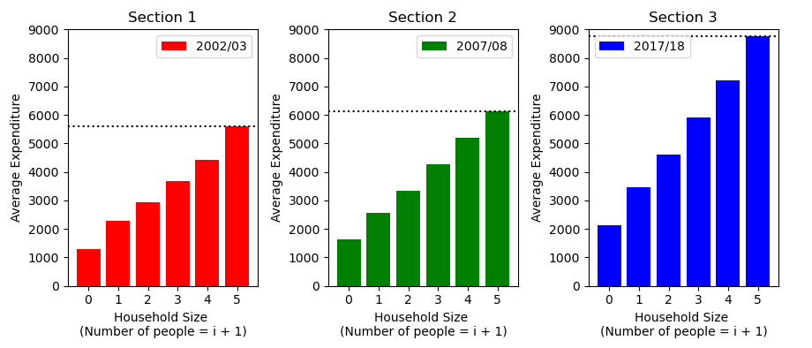
Average Monthly Household Expenditure Among Resident Households
Disclaimer:
This is just an inference and household expenditures may not have any relationships with employment.
However, the chart shown proves that the trend does not appear to be false
Generally, there is an increase in the average monthly household expenditures for all household sizes throughout the 3 sections.
I will infer that since there is an increase in the monthly expenditures → People are starting to take notice of the higher standards of living → They have a more sense of urgency to find a job to cover these expenditures → Increases the employment in Singapore.

Slide 22
Conclusion
After analysing multiple datasets & graphs, I can conclude the results of the factors mentioned in this slide (Simplified Conclusion of factors):
Total Wage Change = No clear relationship with Employment
Gender = More females improves employment ? (Only if companies are willing to)
Job Vacancy = Higher number of vacant jobs improves employment
Qualifications = Better Qualifications improves employment
Median Duration when Unemployed = Longer duration worsens employment
Average Monthly Household Expenditure = Higher expenditure improves employment
All things considered, I have not covered ALL factors that relates to employment. I have picked out datasets and factors that I found interesting to be covered in this analysis.

Slide 23
Potential Solutions
After concluding, I have come up with potential solutions that may improve employment according to the analysis. However, these solutions are not guaranteed that it will improve employment in Singapore.
Companies
They should hire more females into their companies.
They can offer incentives (e.g. To cover household expenses) which may bring in more people who are willing to be employed.
Individuals
They should attain the highest qualification possible (preferably a Degree).
Try to find a job as early on as possible (e.g. build experience, familiarize with the work environment).

Slide 24
References
Datasets used:
Number of Employed Persons Aged Fifteen Years and Over: https://stats.mom.gov.sg/Pages/EmploymentTimeSeries.aspx
Total Wage Change: https://beta.data.gov.sg/collections/676/datasets/d_ae92f125ca6bf7e3bba260c137a68c79/view
Number of Employed Persons Aged Fifteen Years and Over: https://stats.mom.gov.sg/Pages/EmploymentTimeSeries.aspx
Employment Rate of Residents Aged 25 to 64 by Sex: https://beta.data.gov.sg/datasets/d_ca7a8eedf7b8cbe05d5a140a6dc9fc3c/view
Job Vacancy to Unemployed Person Ratio: https://beta.data.gov.sg/collections/652/view
Median Duration among unemployed people: https://beta.data.gov.sg/collections/1919/view
Average Monthly Household Expenditure Among Resident Households (2002, 2003): https://tablebuilder.singstat.gov.sg/table/CT/16659
Average Monthly Household Expenditure Among Resident Households (2007, 2008): https://tablebuilder.singstat.gov.sg/table/CT/16640
Average Monthly Household Expenditure Among Resident Households (2017, 2018): https://tablebuilder.singstat.gov.sg/table/CT/16631

